Slide 2
Building Resilient Microservices with .NET Core and Azure Kubernetes Services (AKS)
Session code here
Steve Lasker
Program Manager – Azure Developer Experiences
@stevelasker
SteveLasker.blog
Shayne Boyer
Cloud Developer Advocate
@spboyer
Notes:
Abstract: Microservices are highly scalable, resilient, and composable units of deployment for modern applications. But building them is hard. There are a lot of development and deployment considerations to take into account. In this session we'll show you how we're making .NET Core microservices easier to build with new application patterns in .NET Core 2.1 as well as how to deploy and manage them with Kubernetes and Helm

Slide 3
Abstract
Building Reliable Systems
What makes a system reliable?
Patterns of reliability
Developing for services that aren’t critical or cable of being 100% reliable
Developing for services that must be available 100%
How Containers can make your service 100% reliable
Why Microservices – is it just the latest fad?
Why microservices enable reliability
No individual service can be 100% reliable
How .NET Core enables reliability
How you can build reliable systems on top of unreliable things

Slide 4
What Makes a System Reliable?
Are individual components 100% reliable?
Is power 100% reliable?
Is network connectivity 100% reliable?
Is the OS and/or Framework 100% reliable?
Is your code 100% reliable?
Does it need to be 100% reliable?

Slide 5
Failure Is A Thing
“If you assume things will fail, you’re prepared for reality”
“It’s not a matter of avoiding failure, it’s preparing for what to do when things fail”
“Building reliable systems, embraces failure and provides for alternative paths”

Slide 6
Balancing the “Cost” of Reliability
What are “costs”?
How much code are you willing to write
How many redundant instances will you pay for?
How many regions should you deploy to
, test
, maintain?
, and pay for?

Slide 7
As Yourself These Questions:
What if that that service didn’t work for _____ amount of time?
Would your customer be able to complete the important task?
Should the whole system fail because one minor piece failed?

Slide 8
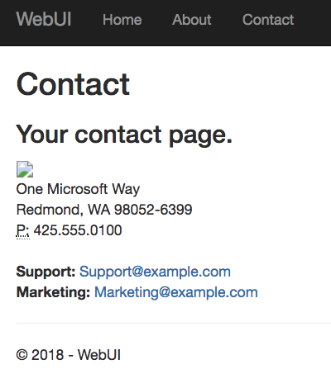
What’s the most basic fault-tolerant feature of HTML?
HTTP 404 - Broken Image
HTTP 404 - Broken Image
What’s the “important” info?

Slide 9
What has changed, in this wave of technology?
Microservices:
Smaller, isolated, idempotent units of capability
Container Orchestration:
designed with failure as a design principal

Slide 10



Release Management
Resource Pool
Orchestration
HOST-A
Deploy:
web:1 x3
quotes:1 x3
important:1 x4
Image Cache
3
web:1
digest: 91e
web:1
digest: 91e
Foo:
web:1 x3
quotes:1 x3
important:1 x4
web:1
digest: 91e
quotes:1
digest: u82
Container Builder
important:1
digest: 2re
important:1
digest: 2re
Container Registry
HOST-B
Image Cache
quotes:1
digest: u82
quotes:1
digest: u82
7
6
quotes:1
digest: u82
5
web:1
digest: 91e
important:1
digest: 2re
important:1
digest: 2re
important:1
digest: 2re
quotes:1
digest: u82
1
quotes:1
digest: u82
docker build –t web:1
docker build –t quotes:1
docker build –t important:1
docker push web:1
docker push quotes:1
docker push important:1
important:1
digest: 2re
important:1
digest: 2re
Image
web:1
quotes:1
important:1
2
Digests
91e
u82
2re
web:1
digest: 91e
HOST-C
quotes:1
digest: u82
4
important:1
digest: 2re
8
Image Cache
quotes:1
digest: u82
quotes:1
digest: u82
important:1
digest: 2re
important:1
digest: 2re
Notes:
Orchestrator icon from: http://cdn.marketplaceimages.windowsphone.com/v8/images/f58edb21-b20c-4315-b837-6cee21n442cd?imageType=ws_icon_large
https://git-scm.com/book/en/v2/Git-Branching-Basic-Branching-and-Merging

Slide 11
Microservice Resiliency
Coding for failure…
Retries – because there will be failures
Timeouts – as it may take longer than your users will wait
Circuit Breakers – so you don’t overload the system
Message Queues – to complete the user task quickly, finish up later

Slide 12






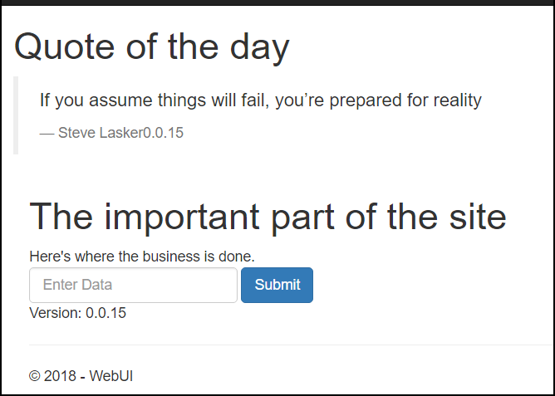
Demo Reference Architecture
web
web
quotes -api
queue- worker
/Demo
quotes -api
queue- worker
ACR Tasks
ACR
ACR Tasks
East US
Important System
web
quotes-api
important-api
Important System

Slide 13
Demo
.NET Core 2.1
Coding for Failure

Slide 14
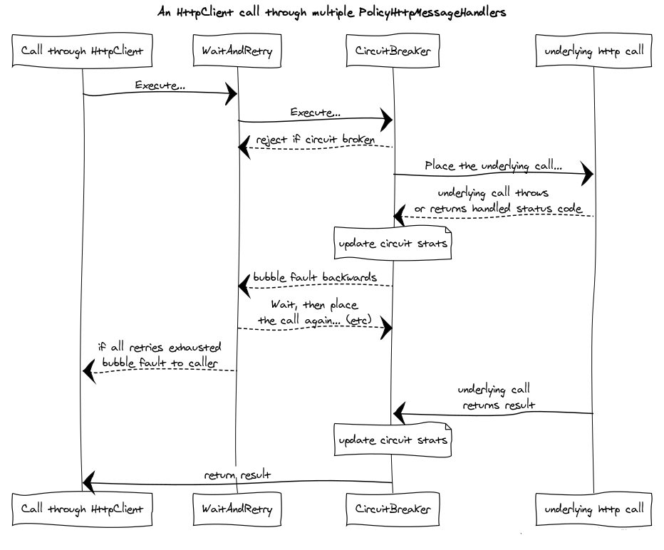

Slide 15
Demo Architecture
web
web
quotes -api
queue- worker
/Demo
quotes -api
queue- worker
ACR Tasks
ACR
ACR Tasks
East US
Important System
web
quotes-api
important-api
Important System

Slide 16

Demo Architecture
ACR demo42.azurecr.io
Geo-replicated
web
web
quotes -api
queue- worker
/Demo
quotes -api
queue- worker
ACR Tasks
ACR Tasks
East US
Important System
web
web
web
web
web
web
quotes-api
queue-worker
quotes -api
queue- worker
quotes -api
queue- worker
Important System
ACR Tasks
West Europe
Important
Storage

Slide 17
Coming into port…
Building 100% reliability is like chasing chickens
“Just when you think you’ve got one, 4 more show up”
Accept failure as the norm; you’ll sleep well at night
Use the modern tools and technologies
“Containers are the unreliable service packaging format”
Orchestrators (Kubernetes) are your nighttime managers
Take the time to fully adapt to container first programming – this is a paradigm shift
.NET Core 2.1 provides coding for the “unreliable pattern”

Slide 18
Specifics We’ve Demo’d
Retries – .NET Core HttpPolicyExtensions (RetryExtensions)
Timeouts – as it may take longer than your users will wait
Circuit Breakers – CircuitBreakerAsync
Message Queues – Azure Storage Queue - .9999 SLA
Extract Configuration – config.AddKeyPerFile(configPath, true)
Kubernetes Secrets – keep your secrets… secret, but fast
State Management – support multiple nodes
services.AddDataProtection()
.PersistKeysToAzureBlobStorage(GetBlobContainer(), "keys");

Slide 19
Info
Demo: github.com/demo42
ACR: aka.ms/acr
ACR Tasks: aka.ms/acr/tasks
ACR Geo-Replication: aka.ms/acr/geo-replication
Azure Kubernetes Service: aka.ms/kubernetes
Helm: aka.ms/helm-repos
ACR Presentations: aka.ms/acr/presentations
Blog: SteveLasker.blog
Twitter: @SteveLasker
Email: SteveLas@Microsoft.com

Slide 20
Please evaluate this session Your feedback is important to us!
Please evaluate this session through MyEvaluations on the mobile app or website.
Download the app: https://aka.ms/ignite.mobileApp
Go to the website: https://myignite.techcommunity.microsoft.com/evaluations

